Slide 1
IPSOMEDT Marine Tool
ROLLS-ROYCE ELECTRICAL, SINGAPORE
Presenters: Wang Zihao

Slide 2
Discussion Overview
Objective
Overall design of IPSOMEDT_Marine
High level architecture
Potential issues

Slide 3
Good software architecture:
Introduction
Readability/Understandability
Maintainability
Scalability
Testability
Reliability/Robustness
Efficiency/Run time
Separation of concerns
Reusability

Slide 4
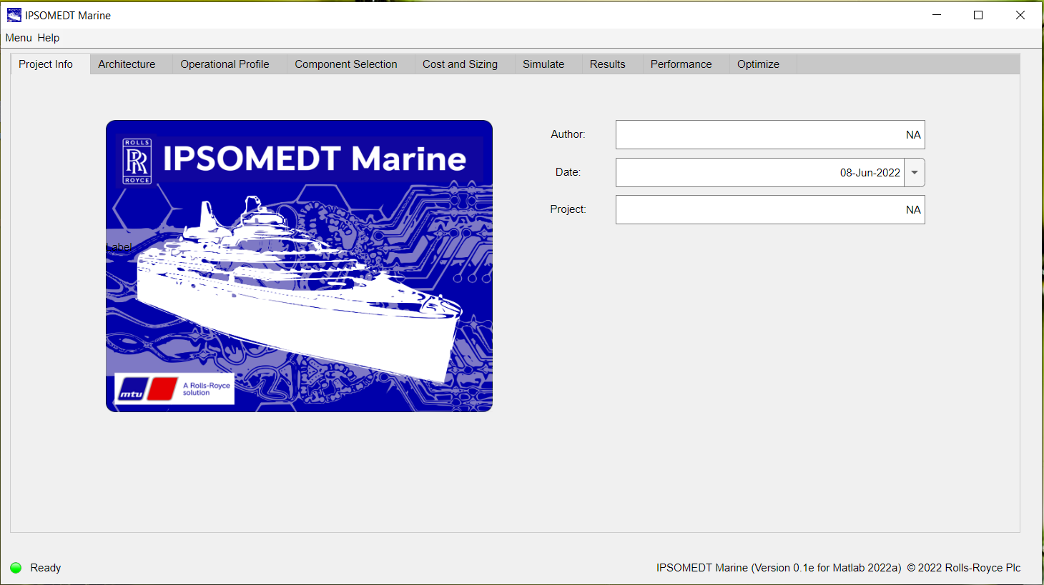
Mlapp with different features and functionalities, optimised for use via GUI
Overall Design

Slide 5
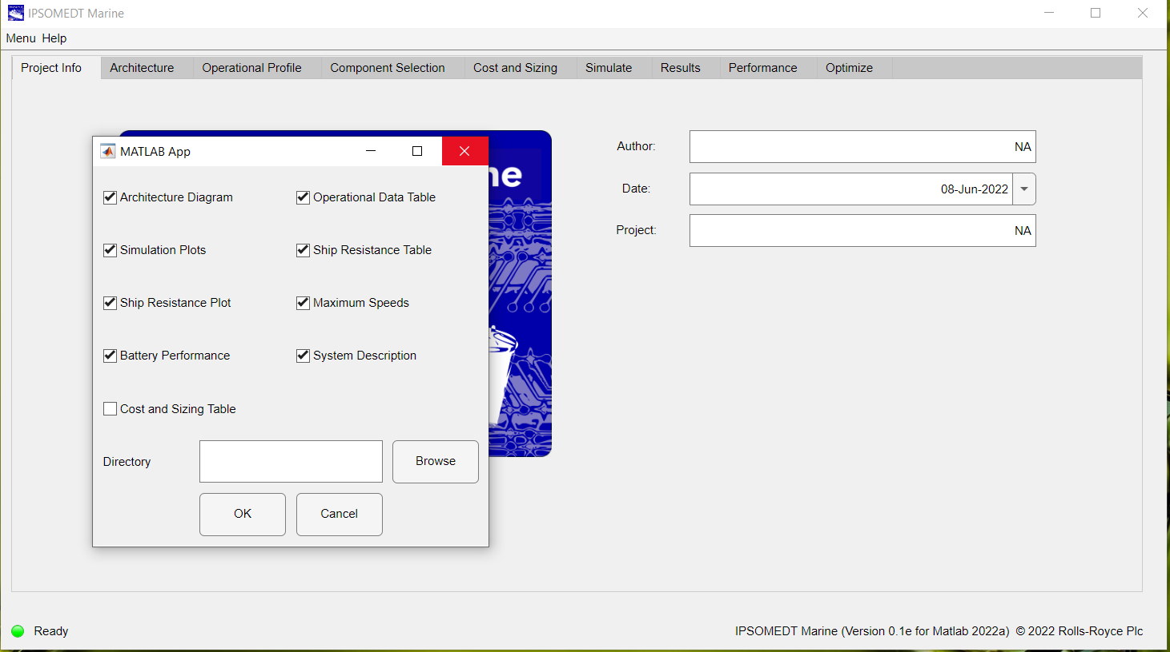
Interaction between dialog app and main app
Overall Design

Slide 6
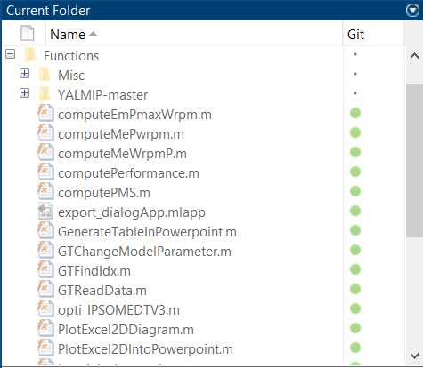
Low-level functions for data computation
High-level Architecture

Slide 7
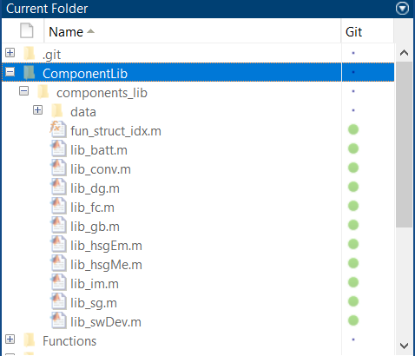
User-defined libraries
High-level Architecture

Slide 8
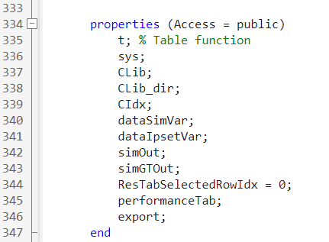
Properties for data storage and classification
High-level Architecture

Slide 9
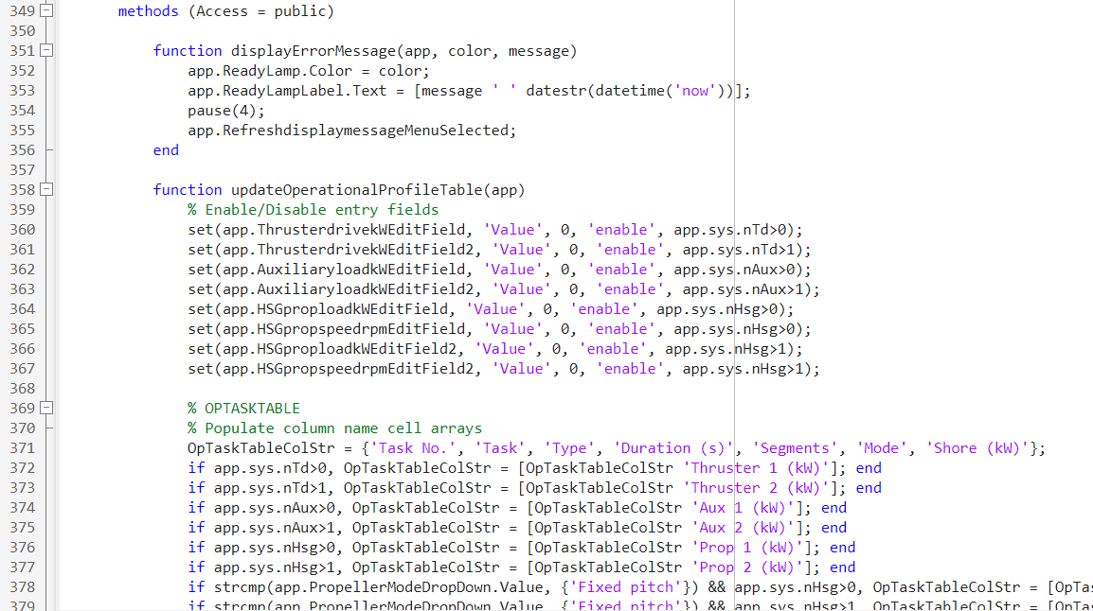
User-defined functions to handle data types and data structures (i.e., for data manipulation purpose)
High-level Architecture

Slide 10
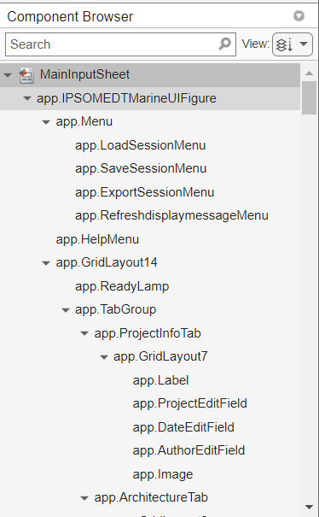
Feature-wise callbacks to construct communication between GUI and code
High-level Architecture

Slide 11
Software architecture
Adapt a microkernel architecture: The system consists of two major components, namely a core system and plug-in modules. The core system handles the fundamental and minimal operations of the application, while the plug-in modules handle the extended functionalities (like extra features) and customized processing.
Advantage: Easiness of feature expansion (i.e., scalability), code understanding without understanding every module (i.e., readability).
Disadvantage: Maintainability, reusability.

Slide 12
Potential Issues
For developer side:
Loading the mlapp file is slow (i.e., loading the existing files and codes).
The editor is slow and delayed.
Compiling and running the mlapp file is slow after clicking the ‘save’ and ‘run’ buttons.
For now, the lagging is still tolerable. But when the mlapp file becomes larger, we foresee the delay will be substantial.

Slide 13
Summary
Refactor user-defined utility functions to another file.
Refactor user-defined libraries to another file.
Use properties and structures to organize variables.
Implement callbacks.
Decrease memory usage by reducing the number of temporary variables.
Perform code vectorization.
Any advices regarding the coding style, code organization, and software
architecture that will potentially speed up the app designer?

